Slide 1
Class 6: Transformers for weather forecasting

Slide 2
Outline
Recap: LSTMs vs Transformers
Self‑Attention & Scaled Dot‑Product
Multi‑Head Attention & Positional Encoding
Transformer Architecture
Dataset & Sequence Preparation
Manual Example & Implementation
Framework Implementation & Results
Comparisons, Variants & Tips
Summary & Reading

Slide 3
Recap & Motivation
RNNs & LSTMs model sequences sequentially; hidden state passes information across time.
Training is inherently sequential and difficult to parallelise.
Long‑range dependencies cause gradients to vanish or explode.
Transformers rely solely on attention and enable parallel computation across positions.
 | LSTM | Transformer
Computation | Sequential | Parallel
Captures | Local & medium dependencies | Long‑range dependencies
Complexity | O(n) | O(n²)

Slide 4
Self‑Attention
We have a bunch of neural networks, created via queries (Q), keys (K) and values (V).
We use these to embed the original input values of our sequence into a latent space which captures the meaning and relationships between the values.
From them we create attention weights that tell us how much influence the input sequence has on itself.
We can do this also for the output sequence, and for the link between the inputs and the output sequence.
We use positional encoding to make sure the order of the sequence matters

Slide 5
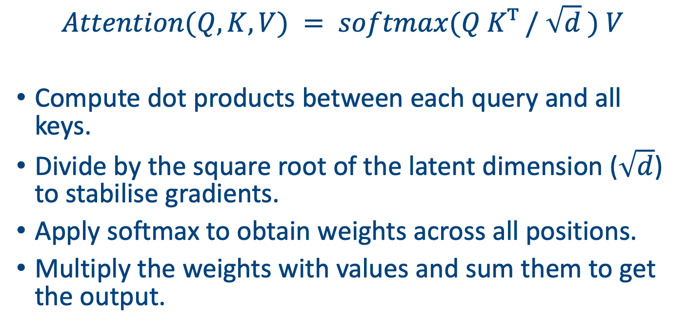
Scaled dot-product attention
$$Attention(Q, K, V) = softmax(Q Kᵀ / \sqrt{d} ) V$$
Compute dot products between each query and all keys.
Divide by the square root of the latent dimension ($\sqrt{d}$) to stabilise gradients.
Apply softmax to obtain weights across all positions.
Multiply the weights with values and sum them to get the output.

Slide 6
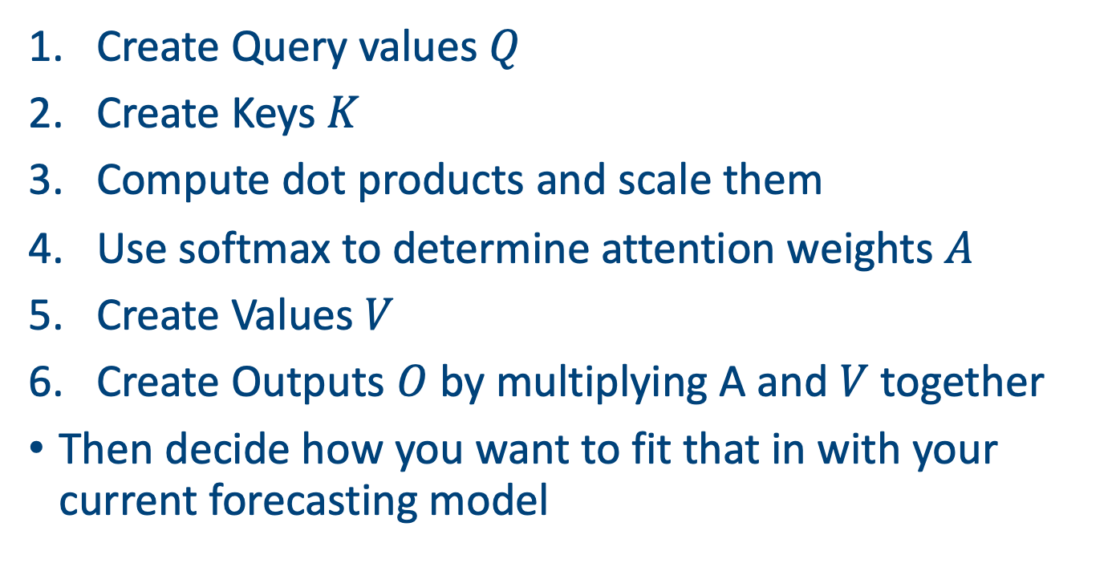
Steps
Create Query values $Q$
Create Keys $K$
Compute dot products and scale them
Use softmax to determine attention weights $A$
Create Values $V$
Create Outputs $O$ by multiplying A and $V$ together
Then decide how you want to fit that in with your current forecasting model

Slide 7
Numerical example
Go through on board

Slide 8
Multi-head attention
We have simplified everything.
We could have:
Used more latent dimensions (and potentially changed them through the keys).
Replaced the creation of queries keys and values with full NNs.
Performed independent attentions to create a multi-head attention blocks.
Added in a decoder.

Slide 9
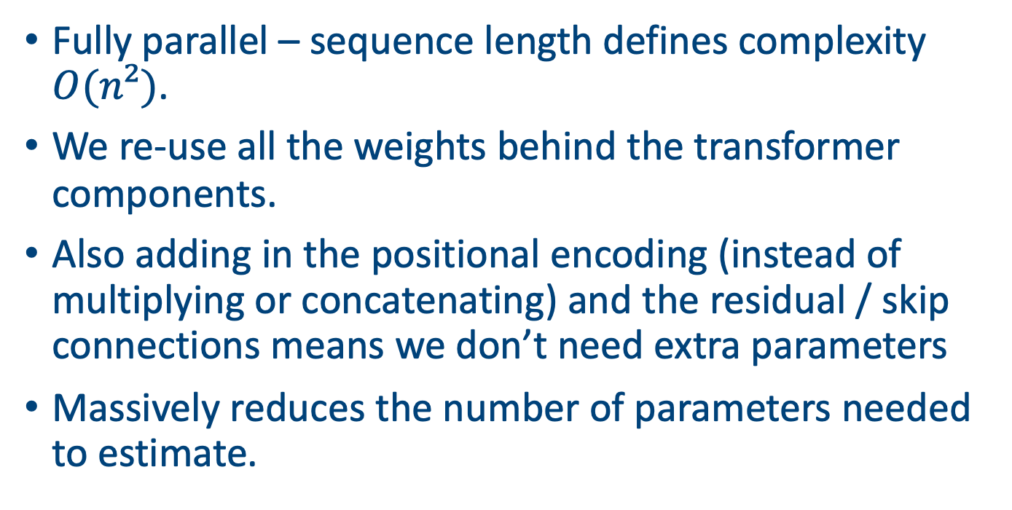
The huge benefit of transformers
Fully parallel – sequence length defines complexity $O(n²)$.
We re-use all the weights behind the transformer components.
Also adding in the positional encoding (instead of multiplying or concatenating) and the residual / skip connections means we don’t need extra parameters
Massively reduces the number of parameters needed to estimate.

Slide 10
Weather task again
Goal: Given weather data from previous days (temperature, rainfall, humidity), predict the next day’s values.
Sequence length (window) determines how far back we look.
We can use our data sets in the data folder

Slide 11
Sequence preparation
Given window length L, we create sequences x[t–L+1…t] as inputs and x[t+1] as target.
Could change the targets to more detailed or longer forecasts
Transformer processes the entire window simultaneously.
Think back to the steps we have just followed.
1
2
3
4
target

Slide 12
Transformers by hand
import numpy as np # projection matrices W_Q = np.random.randn(d_model, d_k) W_K = np.random.randn(d_model, d_k) W_V = np.random.randn(d_model, d_v) # project inputs to queries, keys, values Q = X @ W_Q K = X @ W_K V = X @ W_V # compute scaled dot‑product attention scores = Q @ K.T / np.sqrt(d_k) weights = np.exp(scores) / np.exp(scores).sum(axis=1, keepdims=True) Y = weights @ V
This snippet computes a single attention layer using only NumPy.
No deep learning frameworks required; gradients can be derived manually or via autograd.
(No biases here).

Slide 13
Training in PyTorch
class TinyTransformer(nn.Module):
def __init__(self, d=16, F=1, nhead=4, nlayers=2, H=1, max_len=512):
super().__init__(); self.inp = nn.Linear(F,d); self.pos = nn.Embedding(max_len,d)
layer = nn.TransformerEncoderLayer(d_model=d, nhead=nhead, batch_first=False)
self.enc = nn.TransformerEncoder(layer, nlayers); self.head = nn.Linear(d,H)
def forward(self, x): # x: [T,B,F]
T = x.size(0); z = self.inp(x) + self.pos(torch.arange(T, device=x.device))[:,None,:]
h = self.enc(z) # [T,B,d]
return self.head(h[-1]) # last step → [B,H] prediction
# Run (assumes you have x):
model = TinyTransformer(d=16, F=1, H=1) # 1 feature → 1-step forecast
y_hat = model(x) # x: [T,B,1], y_hat: [B,1]

Slide 14
Hyperparameters
d: embedding dimension (e.g., 32–256) – controls representation capacity.
F: number of features.
nheads: number of attention heads (e.g., 4–8) – trade‑off between diversity and computation.
nlayers: number of encoder blocks – deeper networks capture more complex patterns.
H: number of outputs variables (i.e. number of steps ahead).
max_len: Longest length of sequence
Could include other layers: mitigate problems by using e.g. dropout, layer norm, etc

Slide 15
Comparison: LSTM vs Transformer
Transformers offer parallelism and long‑range modelling at the cost of quadratic complexity.
LSTMs remain useful when sequence lengths are moderate and resources limited.
 | LSTM | Transformer
Computation | Sequential | Parallel
Dependency length | Limited | Global
Complexity | O(n) | O(n²)
Interpretability | Hidden gating dynamics | Explicit attention weights
Use cases | Small/medium sequences | Long sequences, NLP, time series

Slide 16
Pre-training
Use, for example, before full model fitting to obtain better values of embeddings or other aspects of the model.
Take a large data set and try to learn something simple from it before you run it on your specific task.
E.g. predict next item in a sequence, mask out some part of the values and predict them.
Makes the later fitting of the model much easier.
Does add computational cost and sometimes worsens bias on training data.

Slide 17
Other variants
Informers & Longformers: design sparse attention patterns to handle long sequences efficiently.
Reformer & Linformer: reduce memory with low‑rank projections.
BERT, GPT: pre‑trained language models; can be adapted to forecasting via fine‑tuning.
Time Series Transformers: embed temporal features and seasonalities.

Slide 18
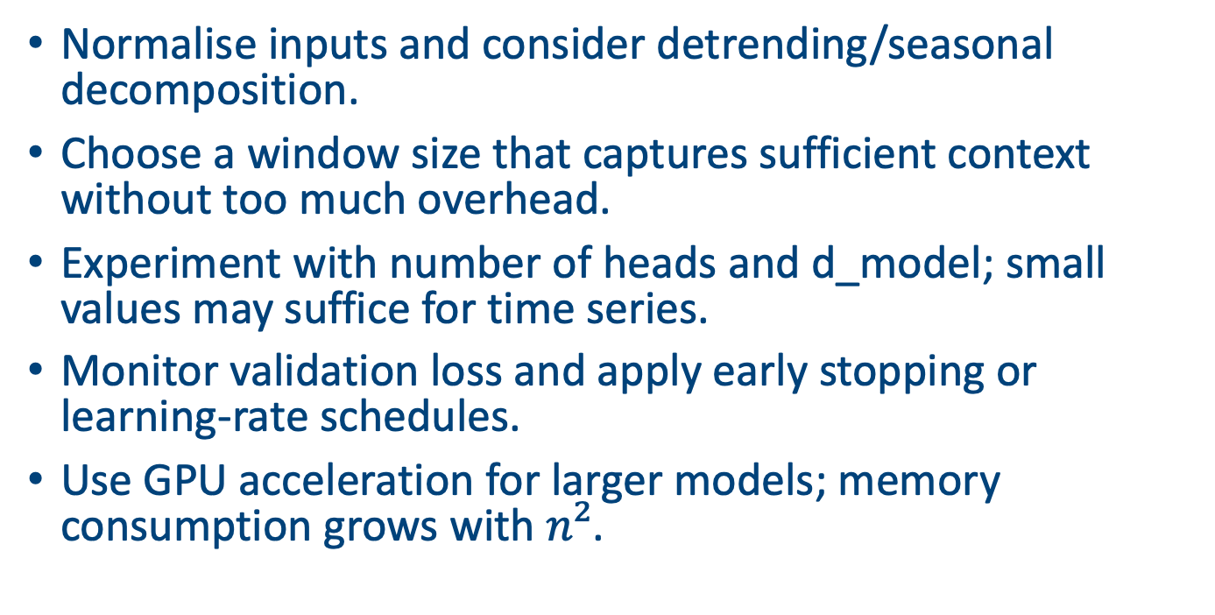
Practical tips
Normalise inputs and consider detrending/seasonal decomposition.
Choose a window size that captures sufficient context without too much overhead.
Experiment with number of heads and d_model; small values may suffice for time series.
Monitor validation loss and apply early stopping or learning‑rate schedules.
Use GPU acceleration for larger models; memory consumption grows with $n²$.

Slide 19
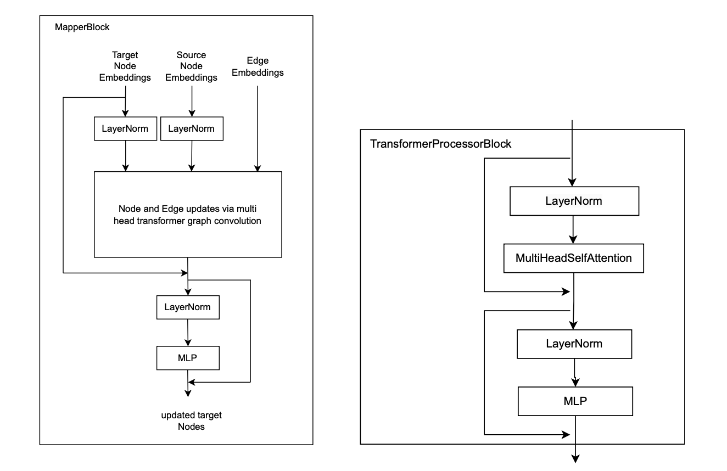
Link with AIFS
Apart from the graph structure (next class) this is exactly the background in ECMWF’s AIFS forecasting system
They predict multiple variables 6 hours ahead
Takes a week to run with 64 A100 GPUs (we only have 16!)

Slide 20
Summary
Transformers replace recurrence with attention, enabling parallelisation and capturing long‑range dependencies.
Scaled dot‑product and multi‑head attention are core building blocks.
Positional encoding injects order information into the model.
On weather forecasting, transformers handle multivariate sequences effectively when sequence length is moderate.
PyTorch makes fitting these kinds of models relatively easy.

Slide 21
Next class
Run through D3C3_code.ipynb

Slide 22
Afternoon session instructions
Use some of the data sets in the data directory (or download your own)
Get an LLM to help you write PyTorch code for that compares an LSTM with a Transformer model
Present your ipynb file in 5 minutes
Presentations: Quinn School of Business Room 115 at 3pm

